Slide 1
Design and Verification of an 8-bit 5-Stage Pipelined RISC Processor
PROJECT PRESENTATION
Verilog HDL · forwarding, stall and flush · AMD Vivado 2026.1 · Artix-7 FPGA
STUDENT
STUDENT ID
Lê Kỳ Dũng
SE190745
Notes:
Good morning. My name is Le Ky Dung, student ID SE190745. Today I will present my project: the design and verification of an 8-bit RISC processor with a five-stage pipeline. I wrote it in Verilog, simulated it, and implemented it for an Artix-7 FPGA in Vivado 2026.1.

Slide 2
The project at a glance
OVERVIEW
A small 8-bit processor that runs up to five instructions at once, handles every pipeline hazard in hardware, and fits in about 1% of an Artix-7 FPGA.
5
16
1.50
121
pipeline stages
IF · ID · EX · MEM · WB
instructions,
16-bit fixed format
CPI on the test program
(51 cycles, 34 instr.)
MHz estimated maximum clock (WNS +1.747 ns)
8-bit 5-Stage Pipelined RISC Processor
Lê Kỳ Dũng · SE190745 · 2
Notes:
Here are the key numbers. The processor has five pipeline stages and sixteen instructions. Every instruction is sixteen bits long. On my test program it reaches a CPI of 1.5, which means on average one and a half clock cycles per instruction. After implementation it meets the 100 megahertz target with 1.747 nanoseconds to spare, so it could run at about 121 megahertz.

Slide 3
Five stages, five instructions in flight
BACKGROUND
IF
ID
EX
MEM
WB
Fetch the instruction at PC
Decode, read registers
ALU, flags, branch decision
Load / store data memory
Write result to register
Cycle | 1 | 2 | 3 | 4 | 5 | 6 | 7
Instr. 1 | IF | ID | EX | MEM | WB
Instr. 2 |  | IF | ID | EX | MEM | WB
Instr. 3 |  |  | IF | ID | EX | MEM | WB
Each instruction still needs 5 cycles, but from cycle 5 one instruction finishes every cycle.
8-bit 5-Stage Pipelined RISC Processor
Lê Kỳ Dũng · SE190745 · 3
Notes:
The processor splits every instruction into five stages: IF fetches the instruction, ID decodes it and reads the registers, EX does the calculation in the ALU, MEM accesses data memory, and WB writes the result back. Like an assembly line, while one instruction is in EX, the next one is in ID and the one after that is in IF. Each instruction still takes five cycles, but after the pipeline is full, one instruction finishes every cycle.

Slide 4
16 instructions, one 16-bit format family
INSTRUCTION SET
0 NOP
1 ADD
2 SUB
3 AND
DECODING EXAMPLE
4 OR
5 XOR
6 SHL
7 SHR
0x823C
8 LDI
9 ADDI
A LD
B ST
C JMP
D BZ
E BNZ
F HLT
1000
001
0
00111100
8 registers R0–R7, 8 bits each; flags Z and C
256 × 16-bit instruction memory, 256 × 8-bit data memory
The upper 4 bits of every instruction are the opcode
opcode 8 → LDI
rd = 001 → R1
imm8 = 0x3C
LDI R1, 0x3C
8-bit 5-Stage Pipelined RISC Processor
Lê Kỳ Dũng · SE190745 · 4
Notes:
The processor has sixteen instructions: arithmetic and logic, shifts, load immediate, load and store, jump, two conditional branches and halt. Every instruction is sixteen bits and the first four bits are the opcode. For example, 0x823C: the opcode is 8, which is LDI; the next three bits select register R1; and the last eight bits are the constant 0x3C. So this instruction loads 0x3C into R1.

Slide 5
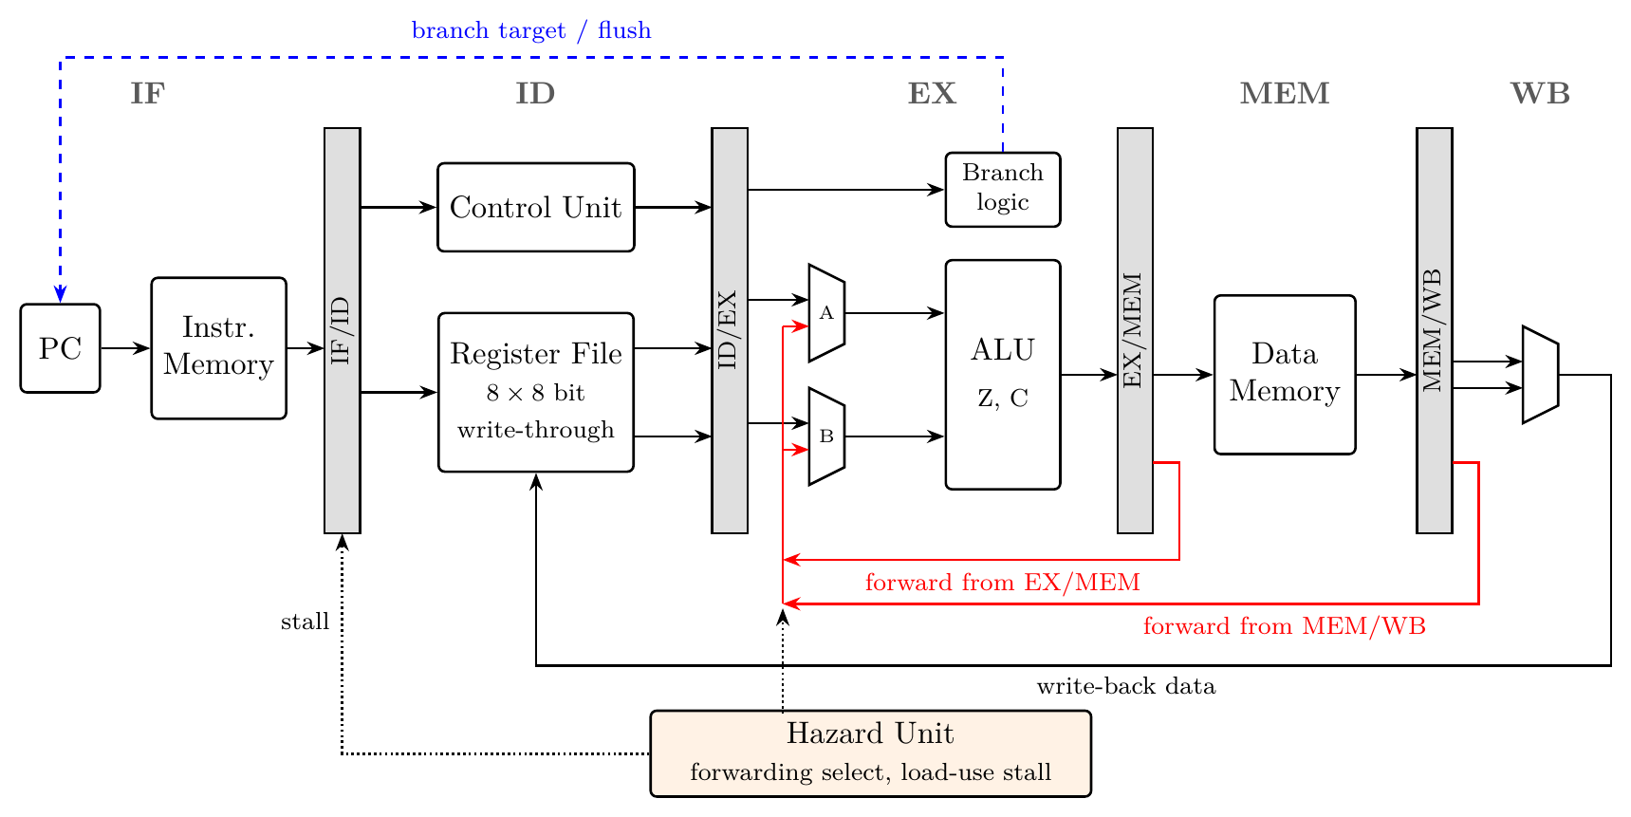
The pipelined datapath
MICROARCHITECTURE
Grey bars
4 pipeline registers: IF/ID, ID/EX, EX/MEM, MEM/WB
Red lines
Forwarding from EX/MEM and MEM/WB back to the ALU inputs
Blue dashed line
Branch target and flush, decided in EX
Hazard unit
Chooses forwarding and stalls on load-use
8-bit 5-Stage Pipelined RISC Processor
Lê Kỳ Dũng · SE190745 · 5
Notes:
This is the datapath. From left to right: the PC and instruction memory in IF; the control unit and register file in ID; the forwarding multiplexers and the ALU in EX; the data memory in MEM; and the write-back multiplexer in WB. The grey bars are the four pipeline registers between the stages. The red lines are the forwarding paths, the blue dashed line is the branch target going back to the PC, and the hazard unit at the bottom controls forwarding and stalling.

Slide 6
Seven modules, one top level
VERILOG DESIGN
File | Stage | Role
imem.v | IF | 256 × 16 instruction ROM holding the test program
control_unit.v | ID | Decodes the opcode into 14 control signals
regfile.v | ID / WB | 8 × 8-bit registers, 2 read ports, write-through bypass
alu.v | EX | ADD, SUB, AND, OR, XOR, SHL, SHR, PASS; Z and C flags
dmem.v | MEM | 256 × 8 data RAM (LUT-RAM)
hazard_unit.v | ID / EX | Forwarding select and load-use stall detection
risc8_5stage_core.v | Top | PC, pipeline registers, flags, branch, flush and halt logic
8-bit 5-Stage Pipelined RISC Processor
Lê Kỳ Dũng · SE190745 · 6
Notes:
The design is written in Verilog-2001 as seven modules. Each module is one part of the processor. The top module, risc8_5stage_core, contains the program counter, the four pipeline registers, the flags and the branch logic, and connects the other six modules together. The hazard unit is the most interesting part, and I will explain it in the next three slides.

Slide 7
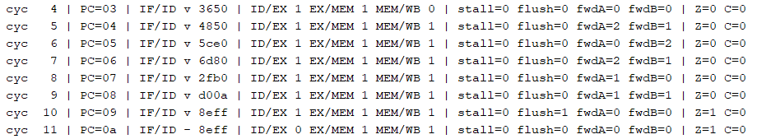
Forwarding: pass the result straight back
HAZARD 1 OF 3 · DATA HAZARD
Problem: AND needs R1, R2 in EX, but they are written only in WB.
LDI R1, 0x3C
Fix: take the value from EX/MEM (sel = 1) or MEM/WB (sel = 2). Distance 3 uses the register-file bypass.
LDI R2, 0x0F
AND R3, R1, R2
needs R2 (1 back) and R1 (2 back)
Simulation trace: cycle 5 shows fwdA=2 fwdB=1 for the AND instruction, so no stall is needed.
8-bit 5-Stage Pipelined RISC Processor
Lê Kỳ Dũng · SE190745 · 7
Notes:
The first hazard is the data hazard. Here, AND needs R1 and R2, but the two LDI instructions before it have not written their results into the register file yet. Instead of waiting, the hazard unit forwards the result directly: from the EX/MEM register if the producer is one instruction back, or from MEM/WB if it is two back. Three back is handled by the register file, which returns the value being written in the same cycle. You can see it in the trace: in cycle 5, fwdA is 2 and fwdB is 1, exactly as expected, and there is no stall.

Slide 8
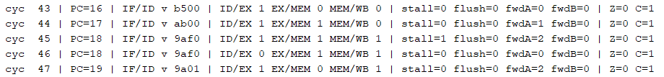
Load-use: wait exactly one cycle
HAZARD 2 OF 3 · LOAD-USE
A load has its data only after MEM, too late for the next instruction’s EX. The hazard unit holds PC and IF/ID for one cycle and inserts a bubble.
Cycle
44
45
46
47
48
49
LD R5,[R4]
ID
EX
MEM
WB
ADDI R5,0xF0
IF
ID
ID · stall
EX
MEM
WB
bubble
—
—
—
—
ADDI R5,1
IF
IF · hold
ID
EX
MEM
Trace: stall=1 in cycle 45; PC stays at 18 and ID/EX is 0 (bubble) in cycle 46.
8-bit 5-Stage Pipelined RISC Processor
Lê Kỳ Dũng · SE190745 · 8
Notes:
Forwarding cannot solve every case. A load gets its data from memory only at the end of the MEM stage, but the next instruction needs it at the start of EX. So the hazard unit stalls for exactly one cycle: the PC and the IF/ID register keep their values, and a bubble, which is an empty instruction, goes into the pipeline. One cycle later the loaded value is in MEM/WB and can be forwarded. In the trace you can see stall equals 1 in cycle 45, and the PC stays at 0x18 for one extra cycle.

Slide 9
Taken branch: flush two wrong instructions
HAZARD 3 OF 3 · CONTROL HAZARD
Cycle
8
9
10
11
12
13
07: BZ 0x0A
IF
ID
EX · taken
MEM
WB
08: LDI R7,0xFF
IF
flushed
09: LDI R6,0x00
flushed
0A: LDI R1,5
IF
ID
EX
Resolved in EX
2-cycle penalty
6 flushes in test
Z flag is ready, PC ← target
Only when taken; not-taken is free
BZ once, BNZ four times, JMP once
8-bit 5-Stage Pipelined RISC Processor
Lê Kỳ Dũng · SE190745 · 9
Notes:
The third hazard is the control hazard. A branch is decided in the EX stage, but by then the processor has already fetched the next two instructions. If the branch is taken, these two are wrong, so they are flushed: the valid bit is cleared and they become bubbles, and the PC jumps to the target. A taken branch costs two cycles; a branch that is not taken costs nothing. In the test program this happens six times. The wrong-path instructions would have changed R7 and R6, and the final values prove they never executed.

Slide 10
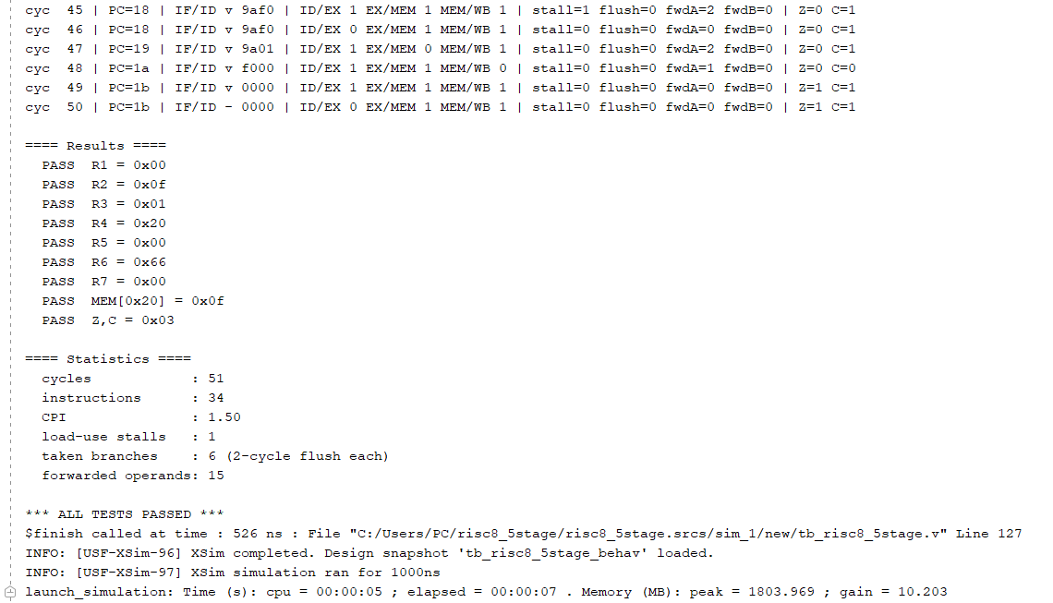

Self-checking testbench: all checks pass
VERIFICATION
9 / 9 PASS
R1–R7, MEM[0x20] and the Z, C flags match the expected values.
R3, R6, R7 correct → the wrong-path instructions were really flushed.
The test covers every hazard: forwarding, stall, BZ, BNZ loop, JMP.
8-bit 5-Stage Pipelined RISC Processor
Lê Kỳ Dũng · SE190745 · 10
Notes:
To verify the design I wrote a self-checking testbench and a 26-line test program that triggers every hazard: forwarding, the load-use stall, a taken BZ, a loop with BNZ, and a JMP. When the processor halts, the testbench compares the registers, one memory location and the flags with the expected values. All nine checks pass, and the simulation ends at 526 nanoseconds with ALL TESTS PASSED. R3, R6 and R7 are especially important: if the flush did not work, the wrong-path instructions would have changed them.

Slide 11
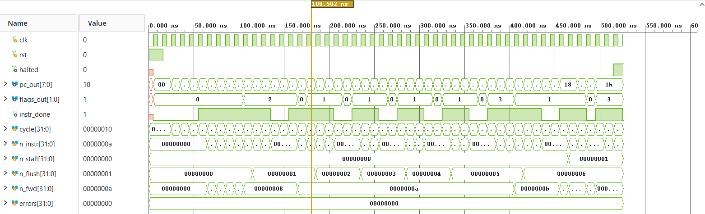
The waveform tells the same story
VERIFICATION
n_flush steps 0 → 6, one per taken branch
n_stall becomes 1 near the end (load-use)
errors stays 0 for the whole run
halted rises at 526 ns after HLT
8-bit 5-Stage Pipelined RISC Processor
Lê Kỳ Dũng · SE190745 · 11
Notes:
This is the waveform from the Vivado simulator. Reset is high for the first two cycles, then the PC starts counting and jumps back several times during the loop. The testbench counters show the hazards: n_flush goes up from zero to six, once for every taken branch; n_stall becomes one near the end, for the load-use case; and errors stays at zero. Finally, halted goes high when the HLT instruction reaches the last stage.

Slide 12
Every extra cycle is accounted for
PERFORMANCE
34
4
1
6 × 2
51
CPI = 51 / 34
+
+
+
=
1.50
instructions
pipeline fill
load-use stall
taken branches
cycles
Same 34 instructions, same clock:
Non-pipelined (5 cycles/instr.)
170
This 5-stage pipeline
51 cycles · about 3.3× faster
8-bit 5-Stage Pipelined RISC Processor
Lê Kỳ Dũng · SE190745 · 12
Notes:
The test program executes 34 instructions in 51 cycles, so the CPI is 1.5. I can explain every extra cycle: four cycles to fill the pipeline at the start, one stall for the load-use case, and two cycles for each of the six taken branches. 34 plus 4 plus 1 plus 12 equals 51. For comparison, a non-pipelined design that needs five cycles per instruction would take 170 cycles, so the pipeline is about 3.3 times faster at the same clock. On longer programs the fill cost disappears and the CPI gets closer to one.

Slide 13
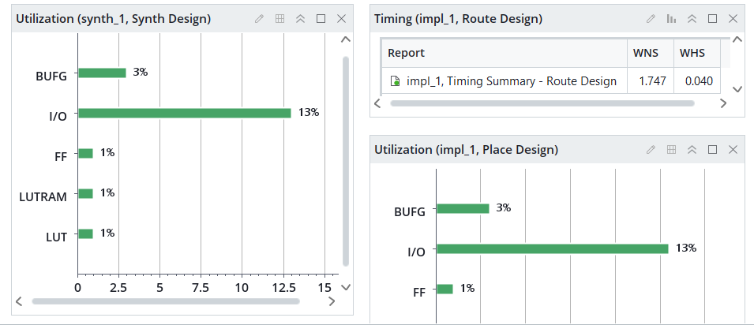
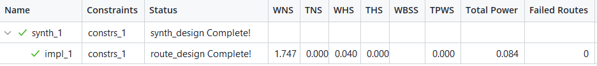
Small, and meets 100 MHz with margin
FPGA IMPLEMENTATION · XC7A35TCPG236-1
Metric | Result
Slice LUTs | 240 (1.2%)
Flip-flops | 186 (0.4%)
Block RAM / DSP | 0 / 0
WNS (setup) | +1.747 ns
WHS (hold) | +0.040 ns
Est. max clock | ≈ 121 MHz
Total power | 0.084 W
Max clock ≈ 1 / (10 − 1.747) ns ≈ 121 MHz
8-bit 5-Stage Pipelined RISC Processor
Lê Kỳ Dũng · SE190745 · 13
Notes:
After simulation I ran synthesis and implementation in Vivado for the Artix-7 xc7a35t chip. The processor uses only 240 lookup tables and 186 flip-flops, about one percent of the chip, and no block RAM or DSP blocks. The data memory is built from LUT-RAM. With a 100 megahertz clock constraint, the worst setup slack is plus 1.747 nanoseconds and the hold slack is also positive, so timing is met. The longest path is about 8.25 nanoseconds, which means the core could run at roughly 121 megahertz. Vivado estimates 0.084 watts total power.

Slide 14
What was achieved, and what comes next
CONCLUSION
Achieved
Future work
Working 5-stage pipeline, 16 instructions, in Verilog
All hazards handled: forwarding, 1-cycle stall, 2-cycle flush
Self-checking test: 9 / 9 PASS, CPI 1.50
240 LUTs, 186 FFs, timing met at 100 MHz (≈ 121 MHz max)
Resolve branches earlier or add branch prediction
Add CALL / RET, a stack and memory-mapped I/O
Load programs from a .hex file instead of the ROM
Run the core on a real FPGA board
8-bit 5-Stage Pipelined RISC Processor
Lê Kỳ Dũng · SE190745 · 14
Notes:
To conclude: I designed a working five-stage pipelined processor with sixteen instructions in Verilog. All data and control hazards are handled in hardware with forwarding, a one-cycle stall and a two-cycle flush. The self-checking testbench passed all nine checks with a CPI of 1.5, and the design meets timing at 100 megahertz using about one percent of the FPGA. In the future, I would like to reduce the branch penalty, add subroutine calls and I/O, load programs from a file, and test the processor on a real board.

Slide 15
Thank you
Lê Kỳ Dũng · SE190745
Notes:
Thank you for listening. I am happy to answer your questions.

